Slide 1
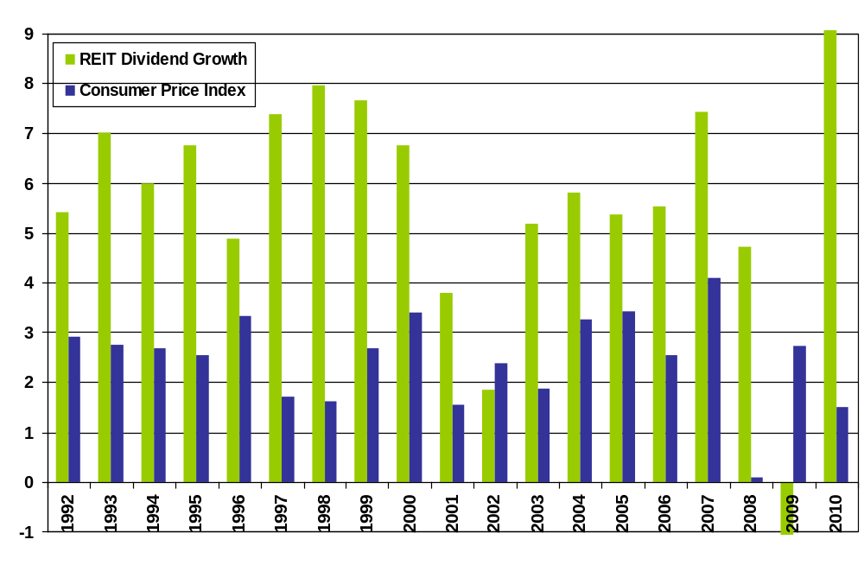
REIT Dividend Growth v. Consumer Price Index
1992-2010
Note: cash dividends declined by 25.3% during 2009, and increased by 47.5% during 2010.
Note: Based on monthly returns. Source: NAREIT® and U.S. Department of Labor.

